Slide 1
Deep Learning models: Online Host , Visualization and Deployment
Presented by
Vamshi Dhraksharam
Goutham Gandreddi
Premchand Lingamgunta

Slide 2
Motivation
With the advances in deep learning applications, sharing the trained models online becomes a critical component of the overall deep learning lifecycle. Currently, trained models are share on private websites or dumped into storage services like GitHub, which cannot visualize the model and its metadata, test it online, or deploy it online.

Slide 3
Project Goal/Objective
Our idea was to develop a web application similar to GitHub for users to host trained models and provide access with everyone to download and can like or comment accordingly.

Slide 4
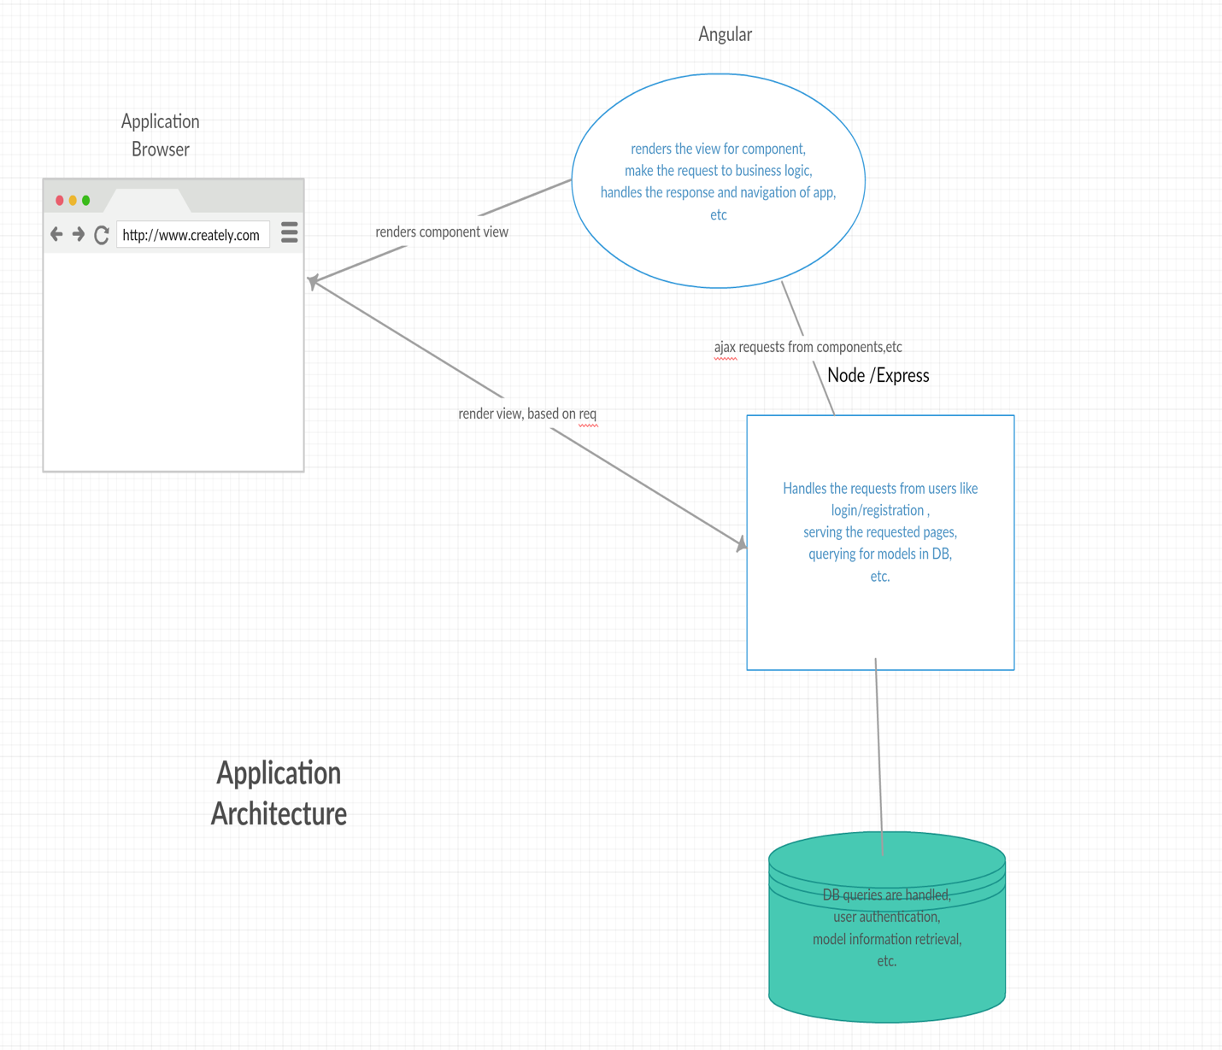
System Architecture

Slide 5
System Features
User Dashboard
State-fullness (using token based authentications & req-handling)
View the model information, files, test-data results.
Create New Model(uploding)
Download the model
Delete the model files
Search & Filter
Like , Dislike and Comment

Slide 6
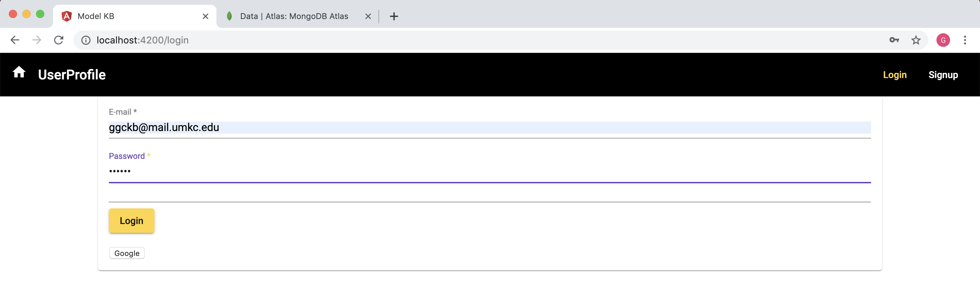
Login

Slide 7
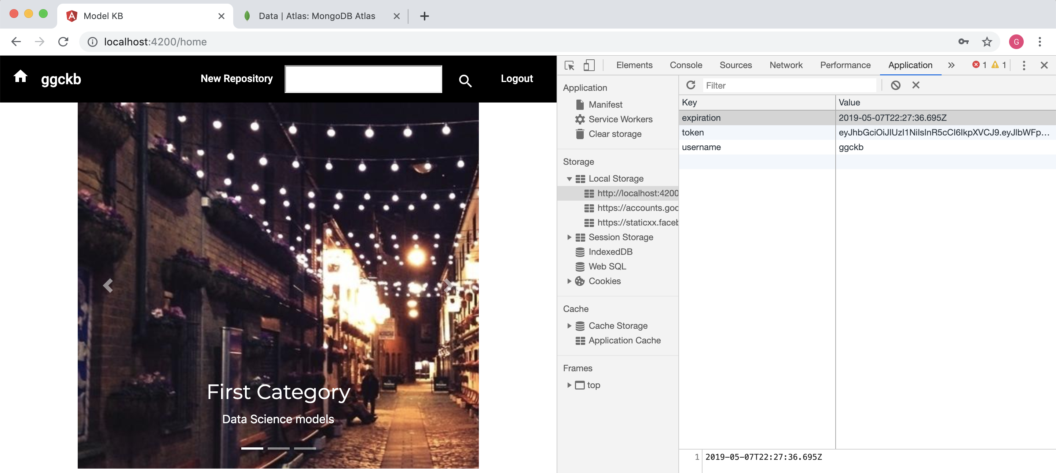
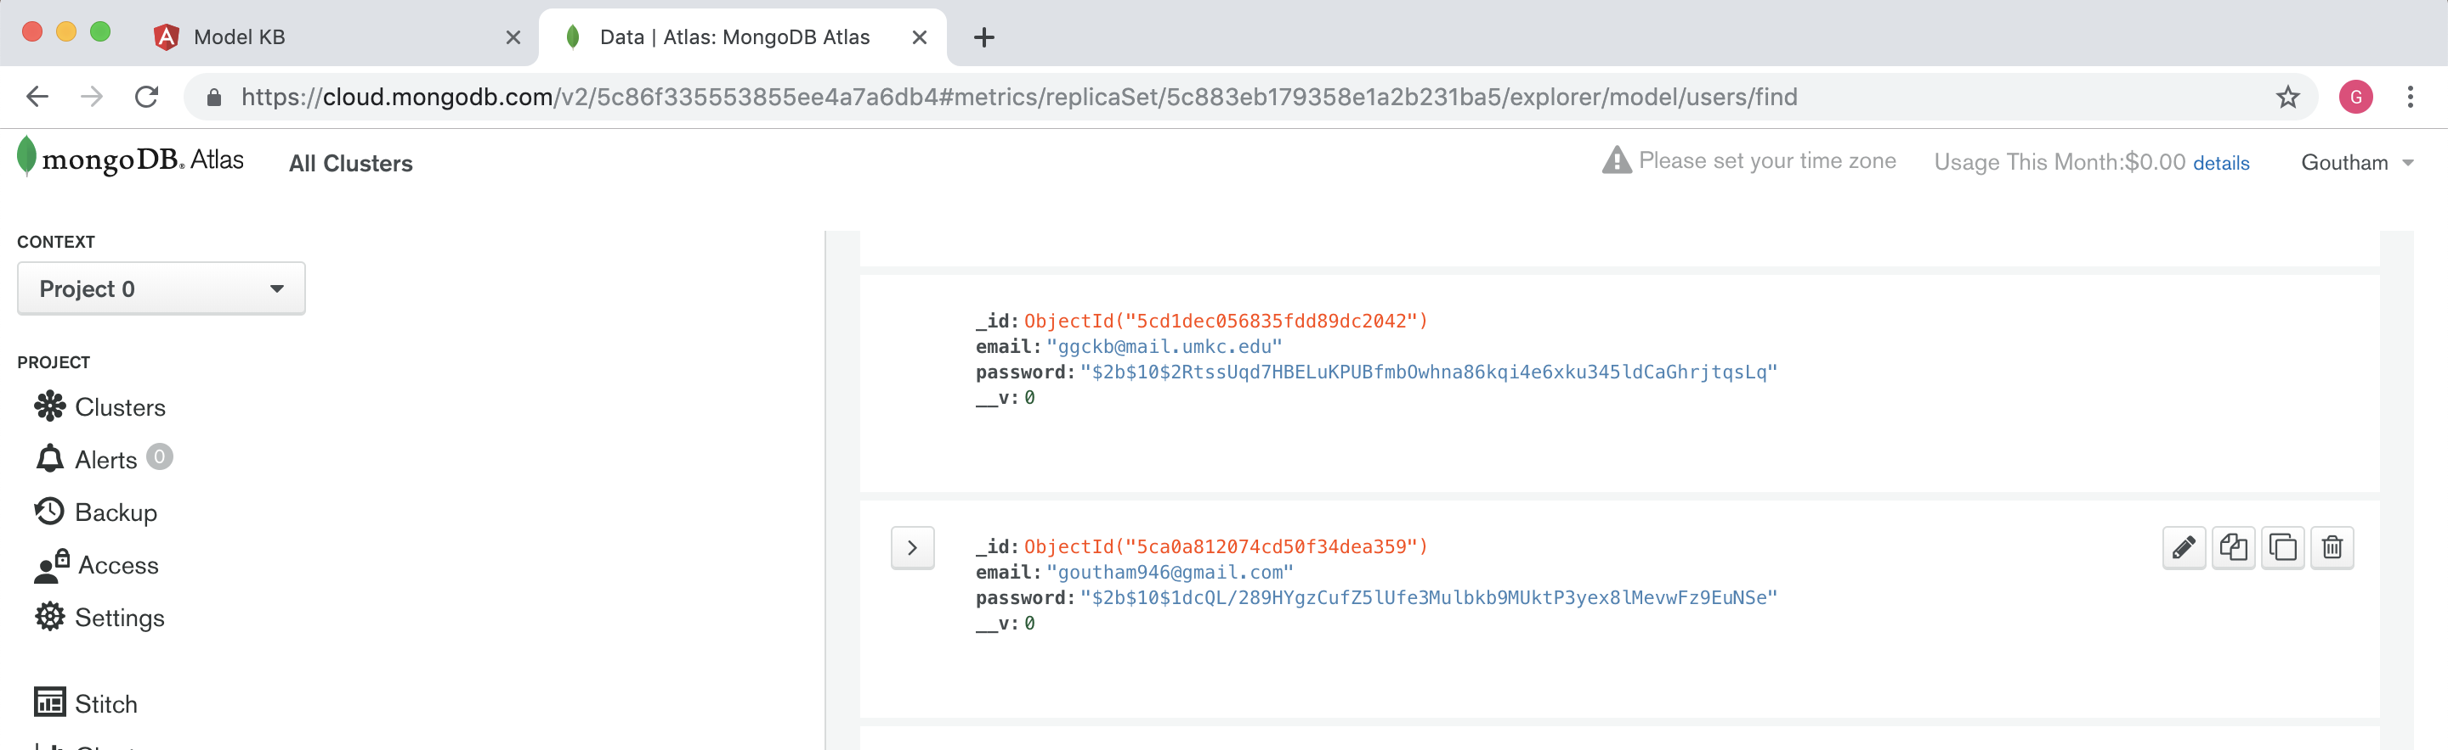
State-fullness (using token based authentications & request handling)

Slide 8
Search and Filter

Slide 9
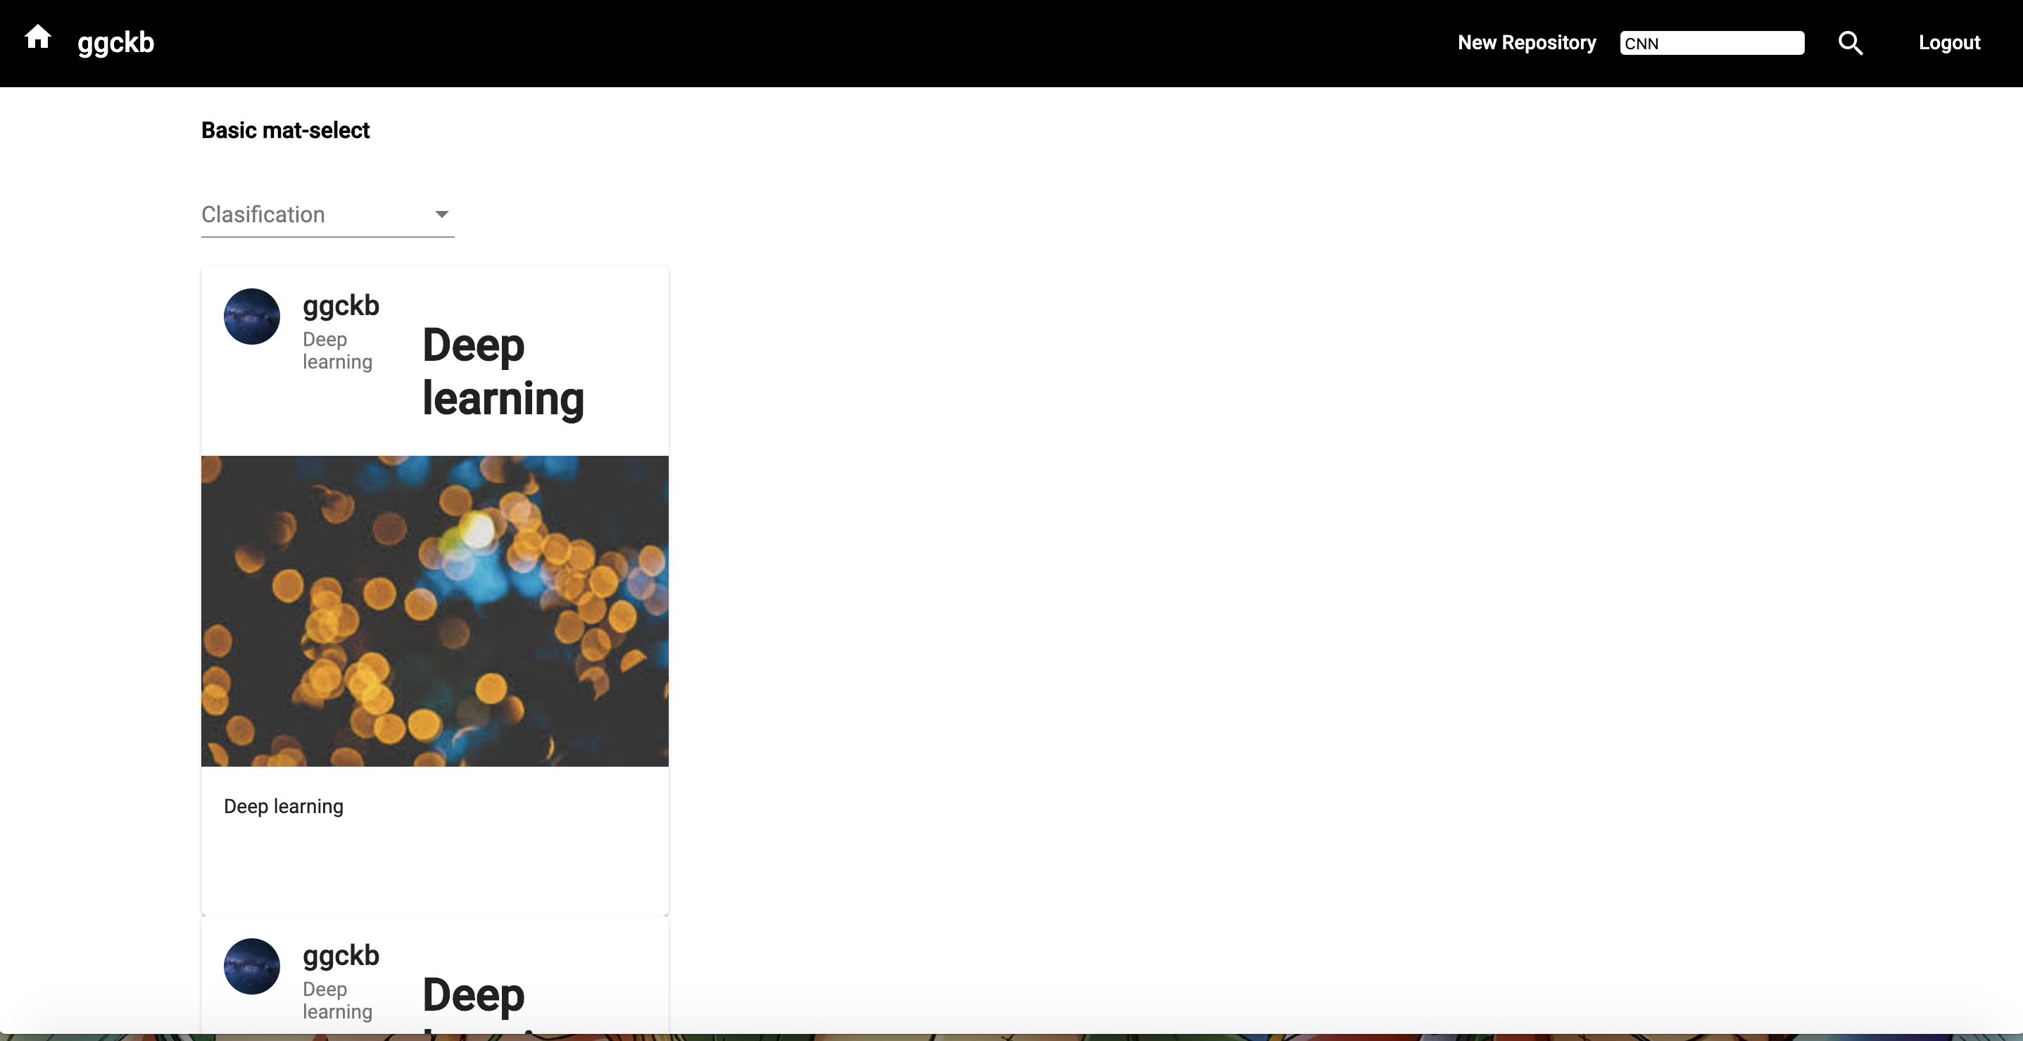
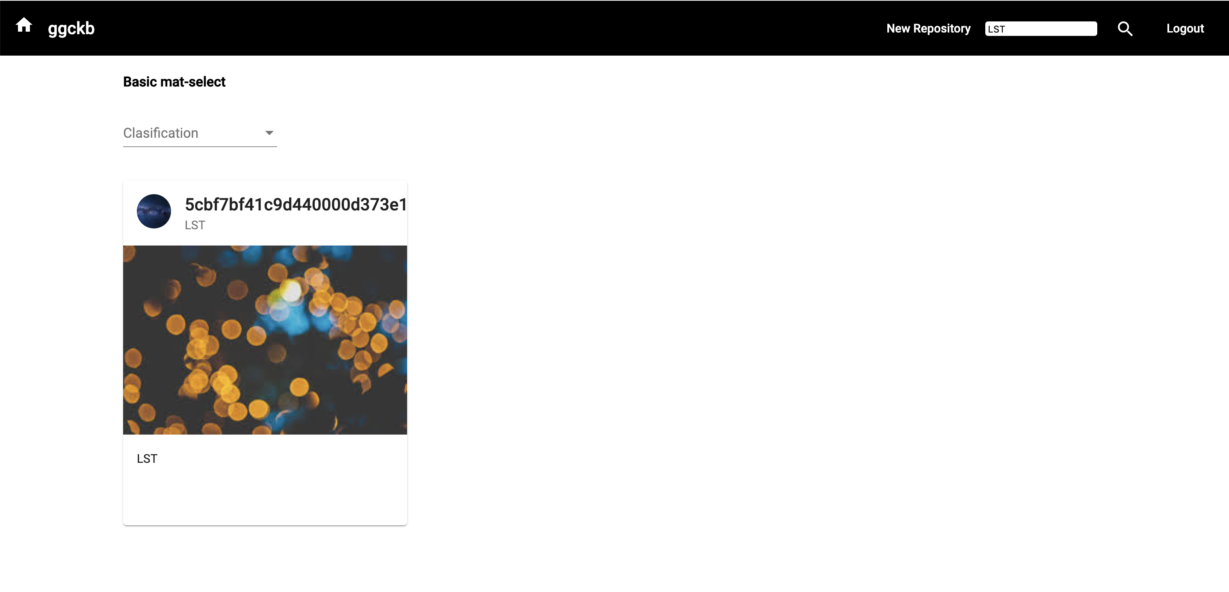
Search

Slide 10
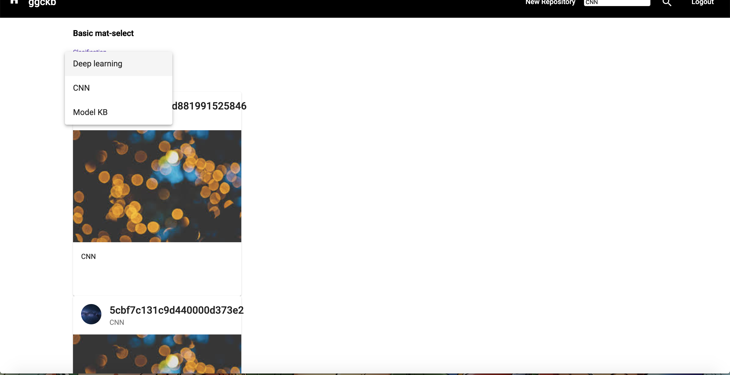
Filter

Slide 11
User Profile

Slide 12
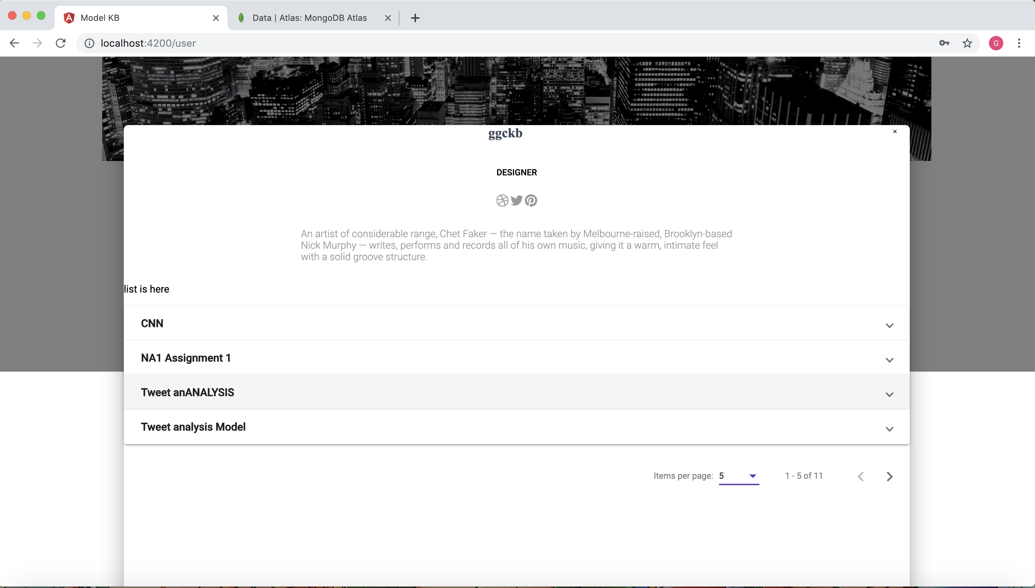
User dashboard

Slide 13
Repository

Slide 14
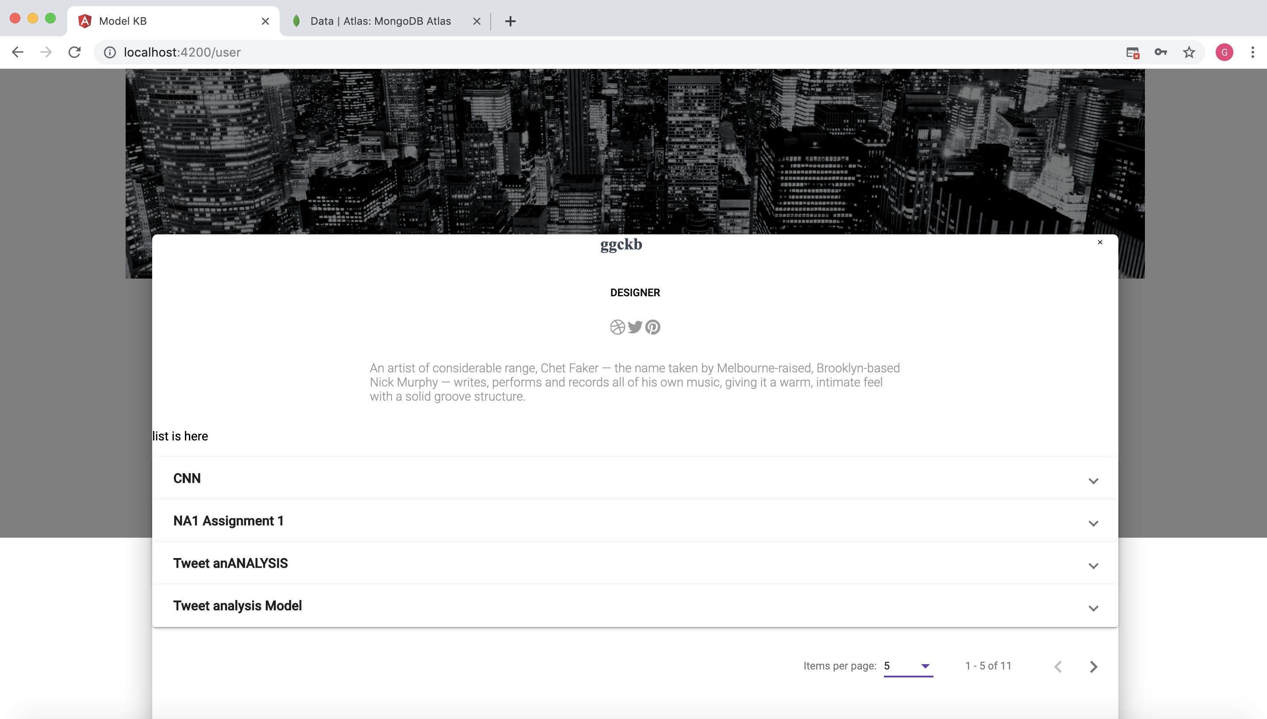
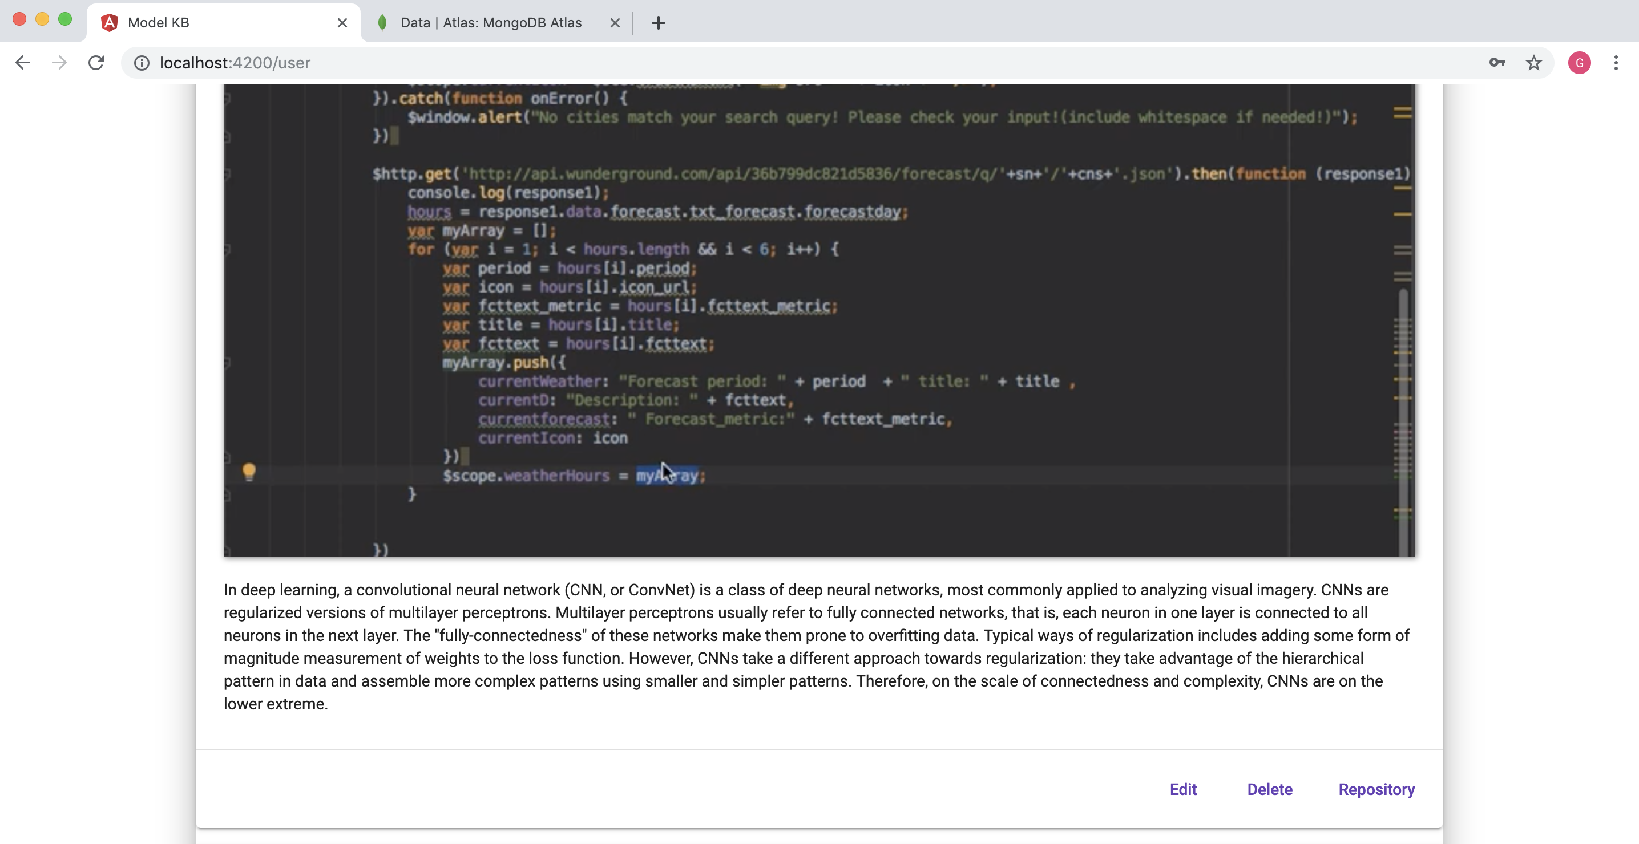
List of models or repos under user

Slide 15
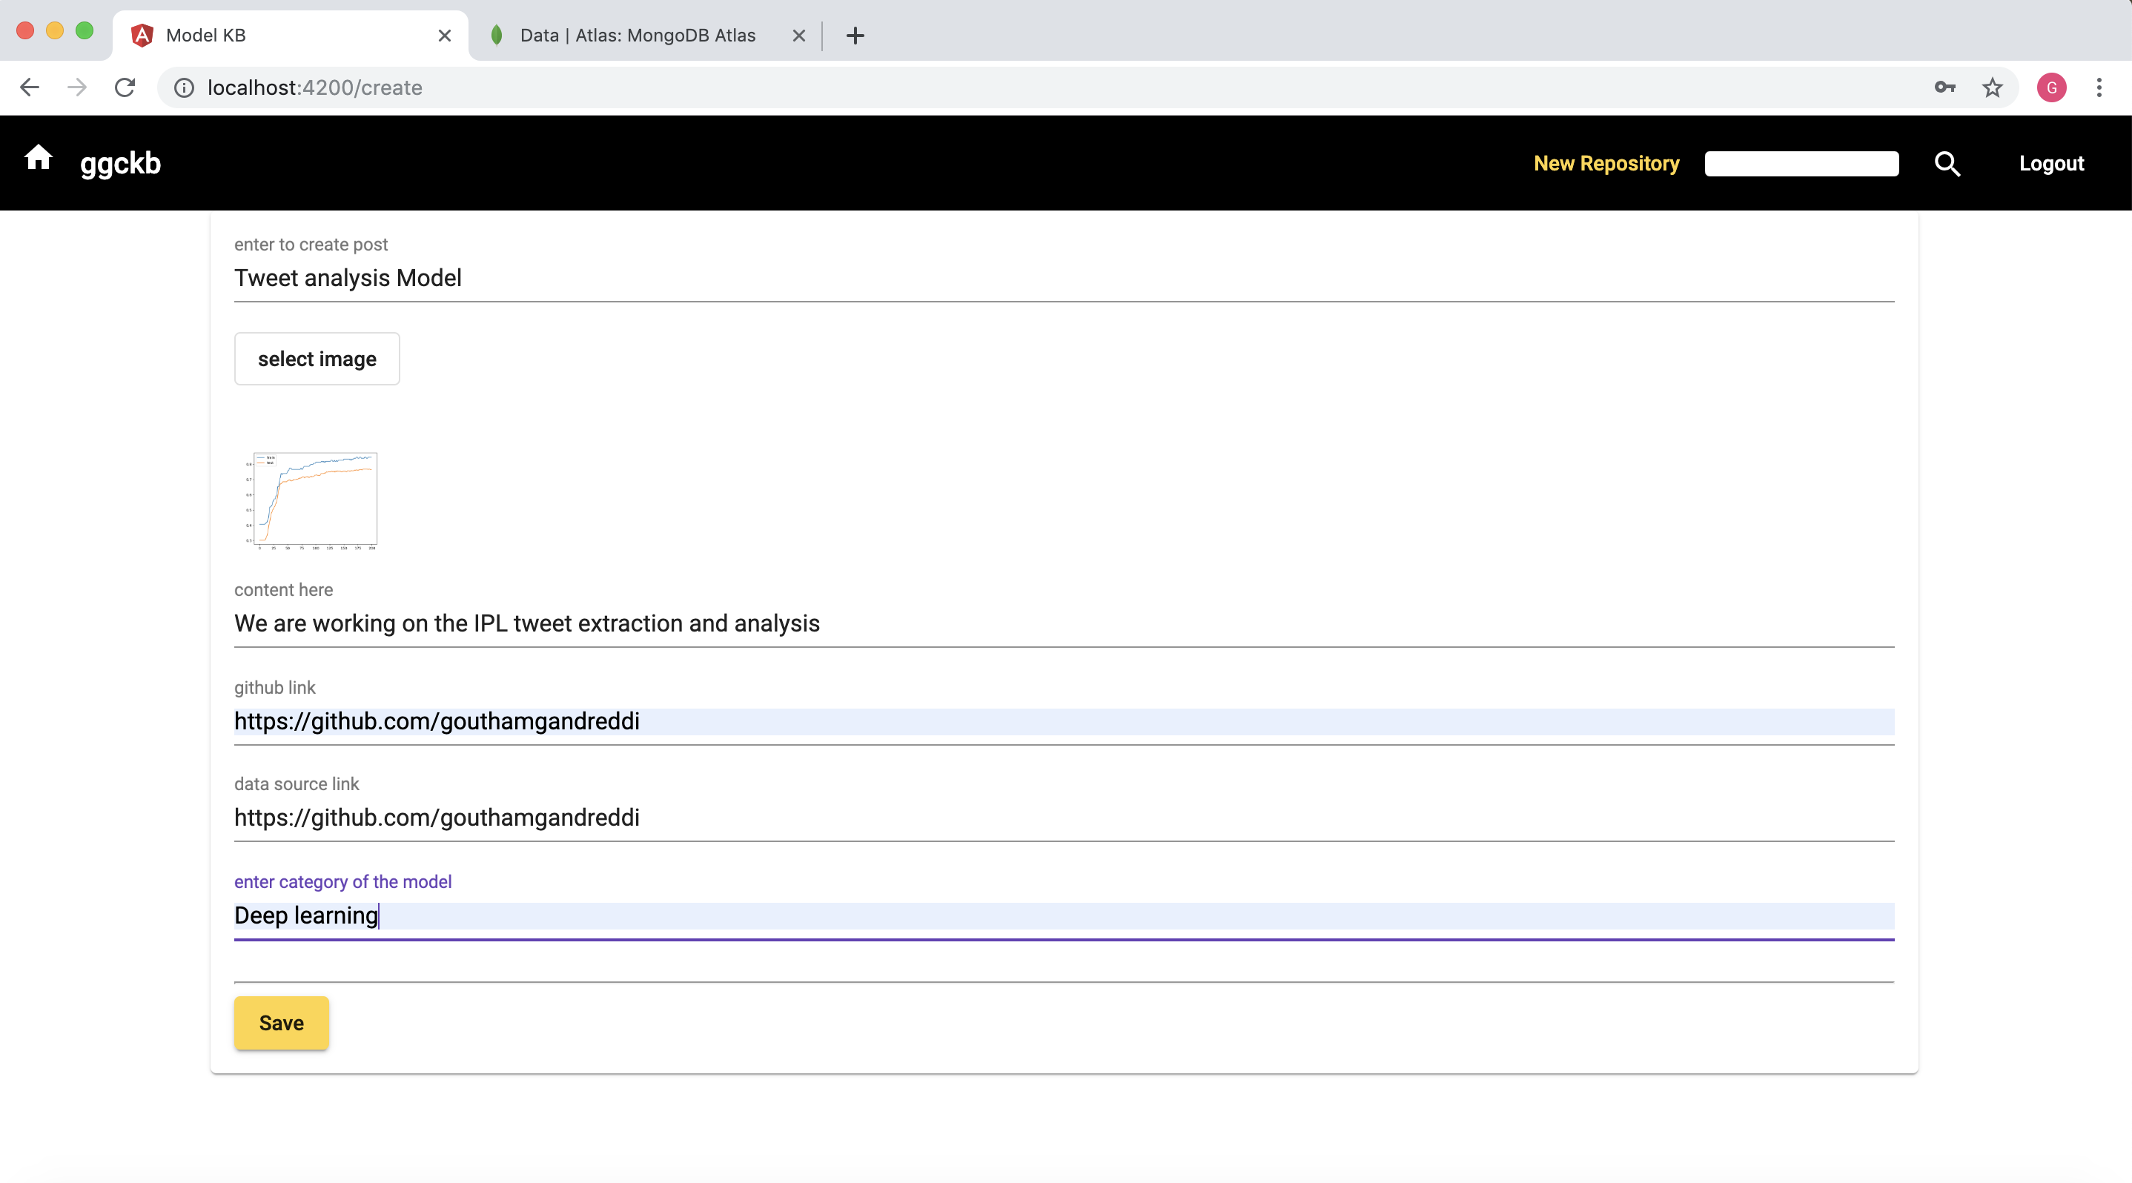
New Repository creation

Slide 16
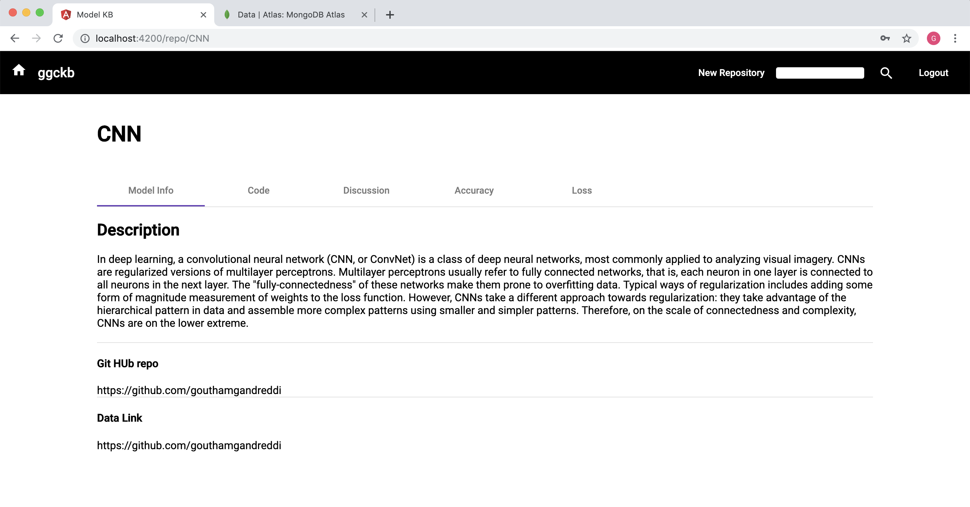

Slide 17
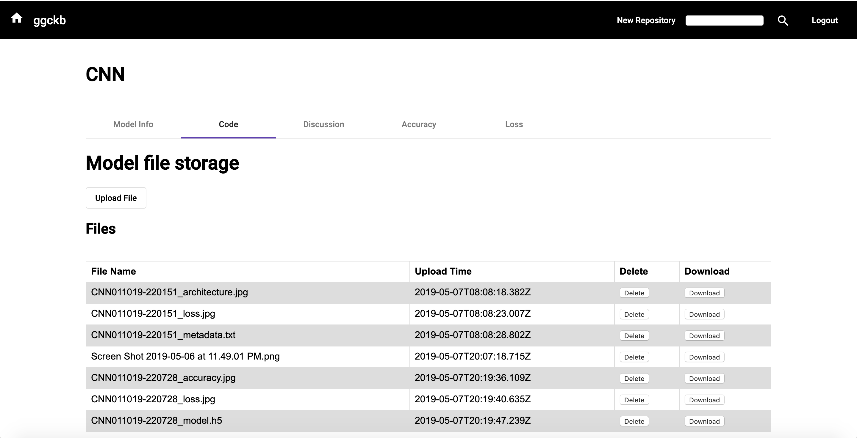

Slide 18
Storing files using GridFS

Slide 19
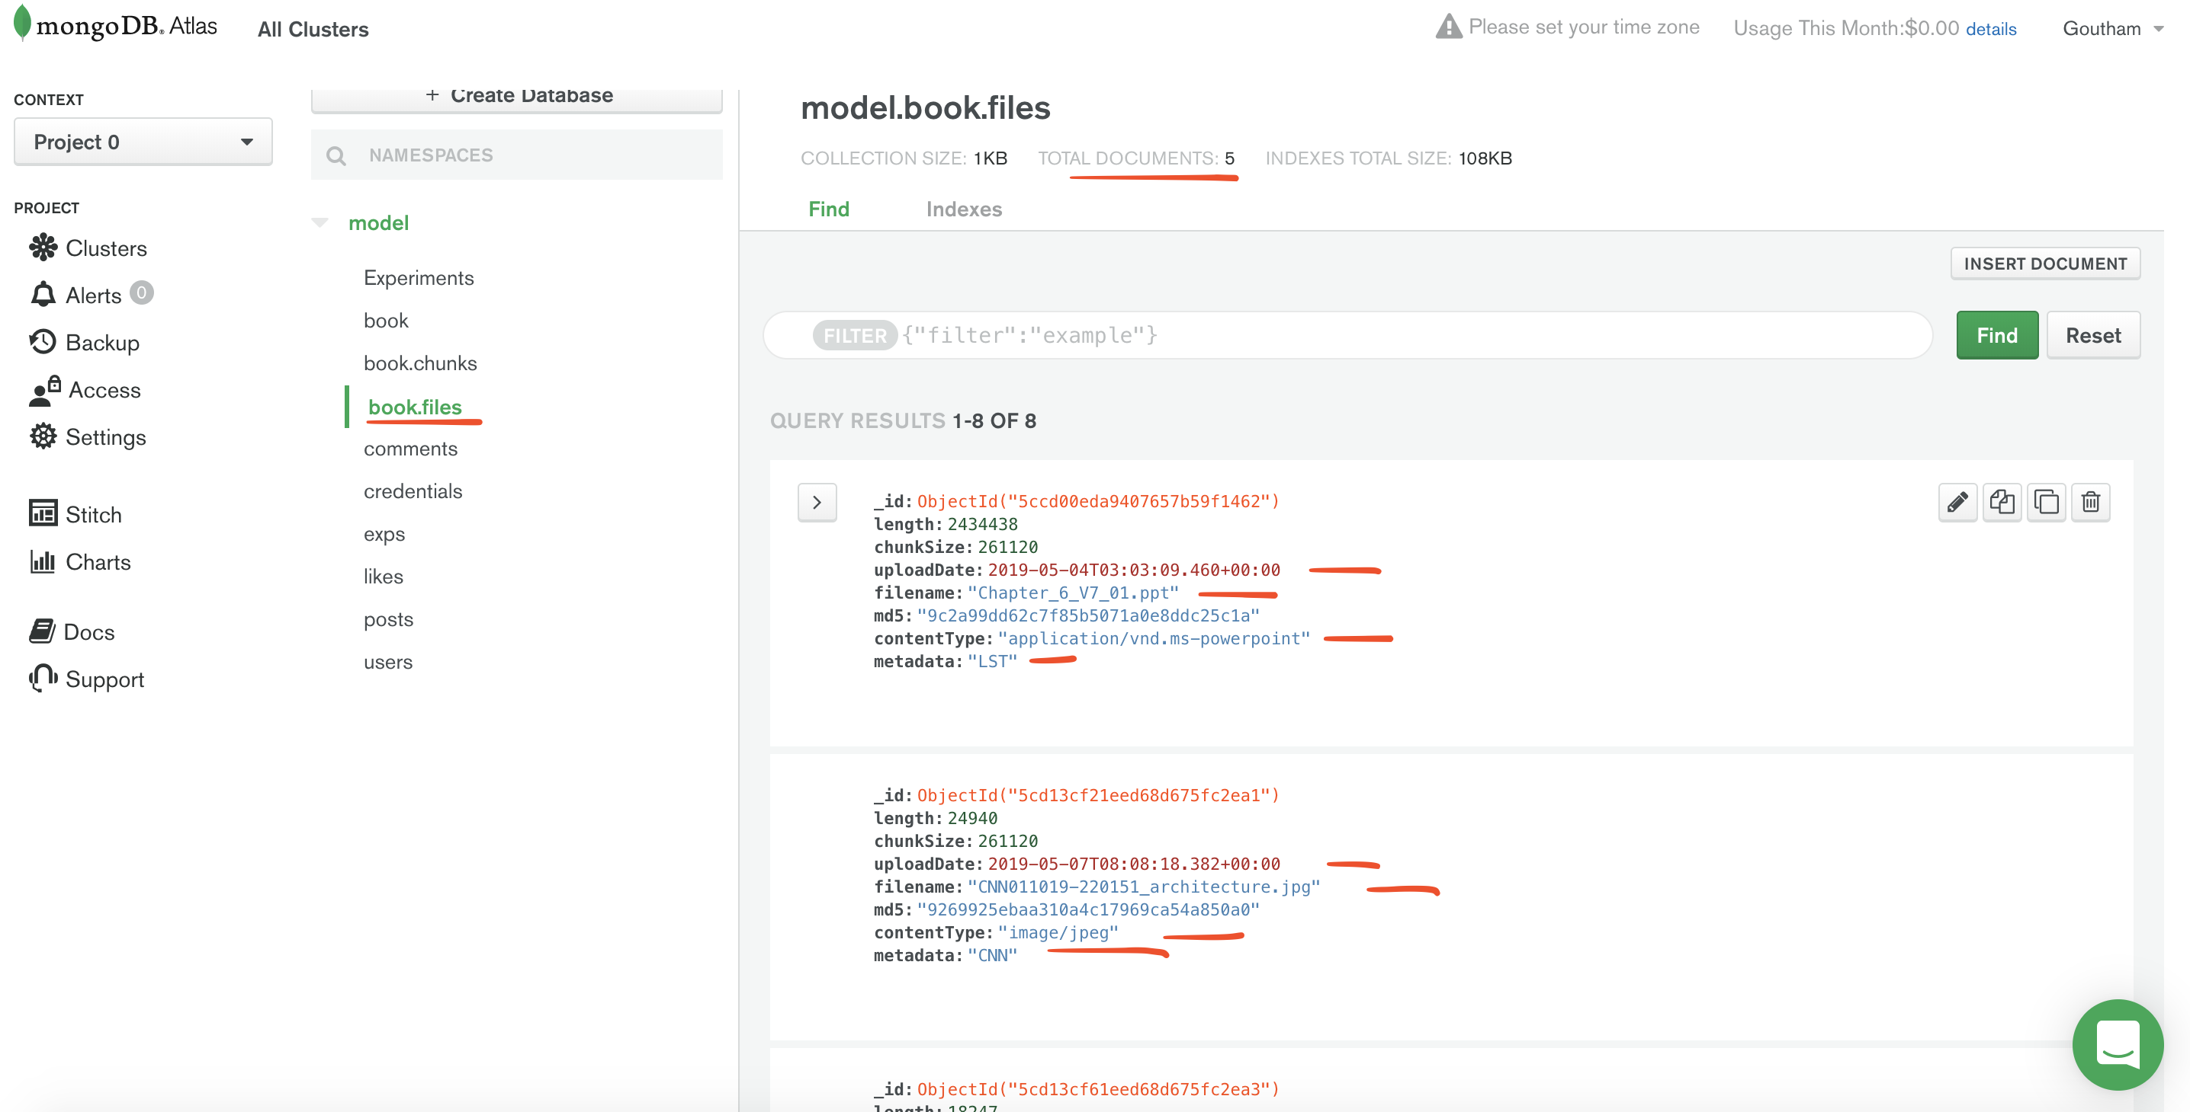

Slide 20
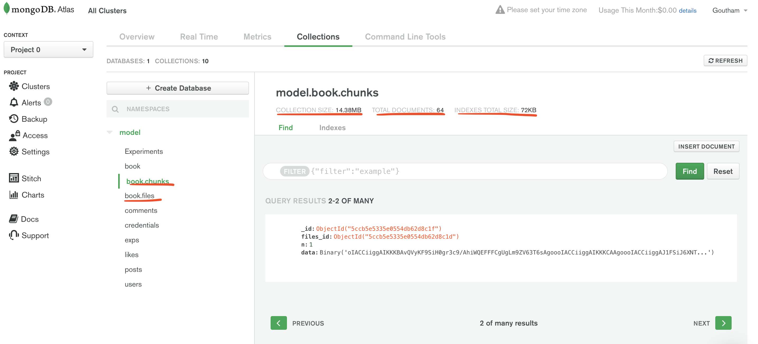

Slide 21
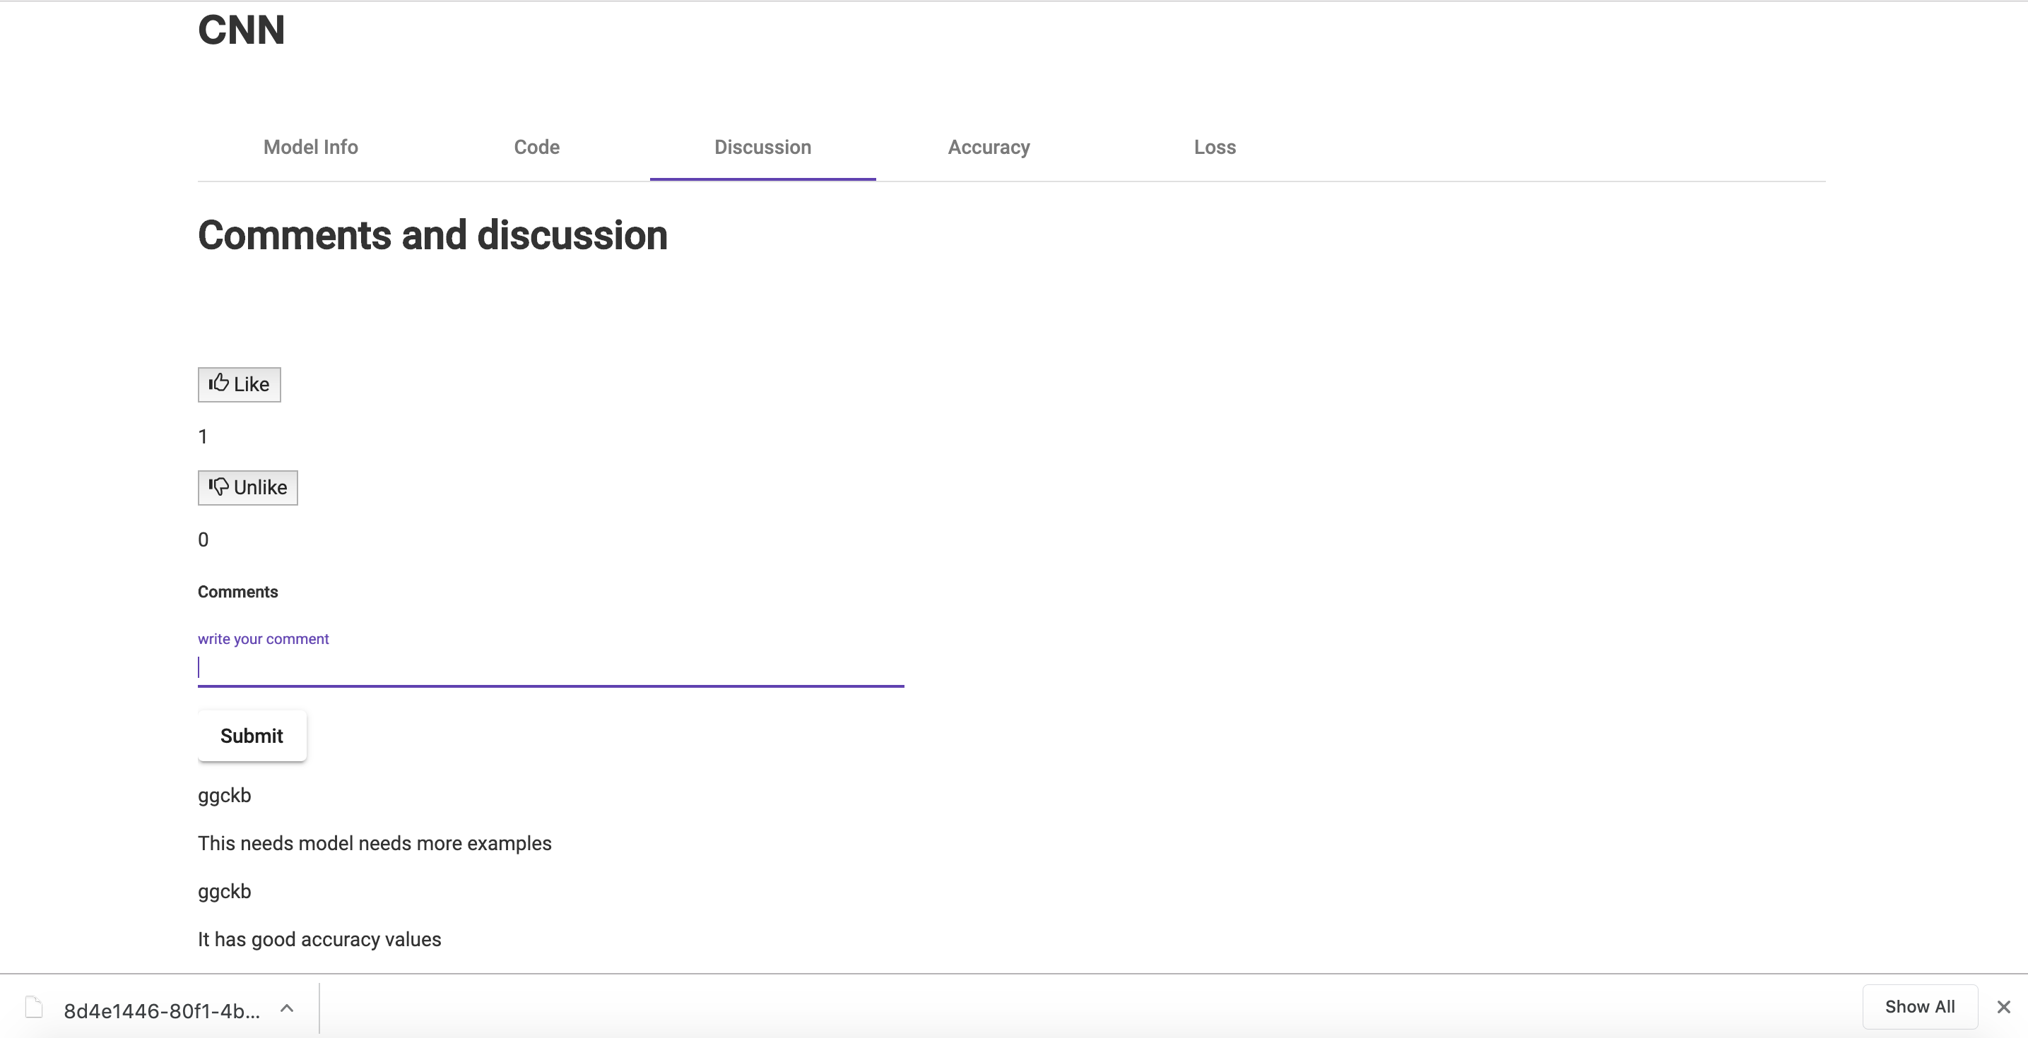
Discussion forum for specific model

Slide 22
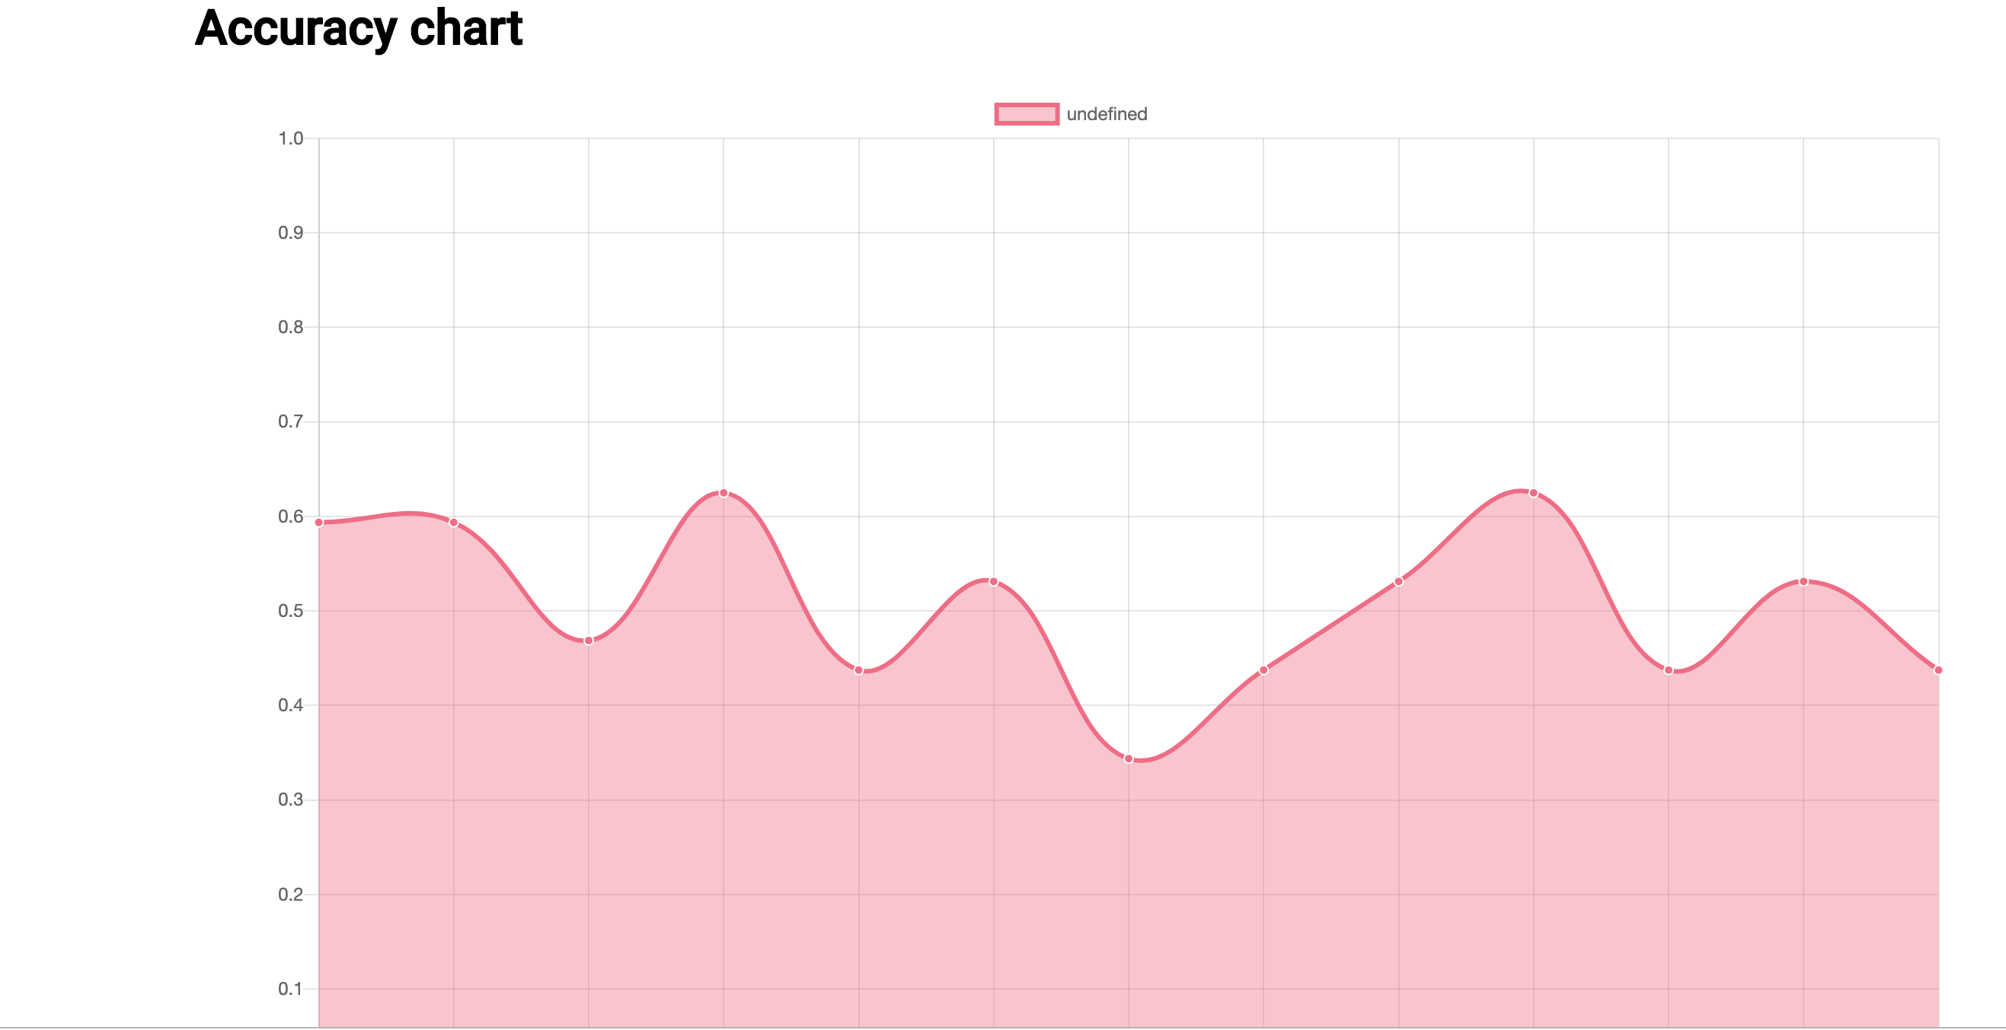
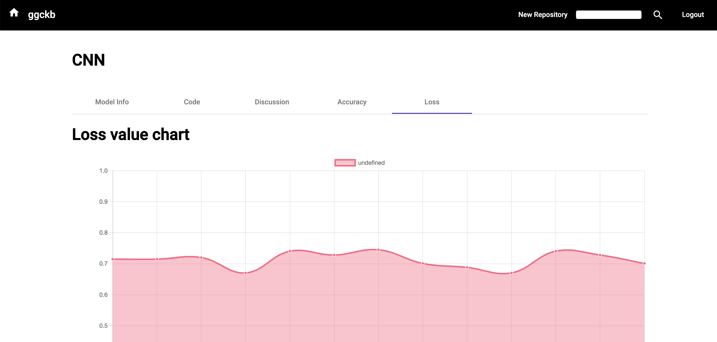
Accuracy and Loss Graphs

Slide 23
Questions ???

Slide 24
Thank you !!!

